Slide 1

(Electronic city campus)
Department Of Mechanical Engineering
MECHANICAL ENGINEERING SCIENCE (MES)
(UE18ME101)
Prof. Sateesh Mudalagi

Slide 2
Unit – 3
Power transmission

Slide 3
Power transmission (rotational power)
Belt drives
Chain drives
Rope drive
Gear drives

Slide 4
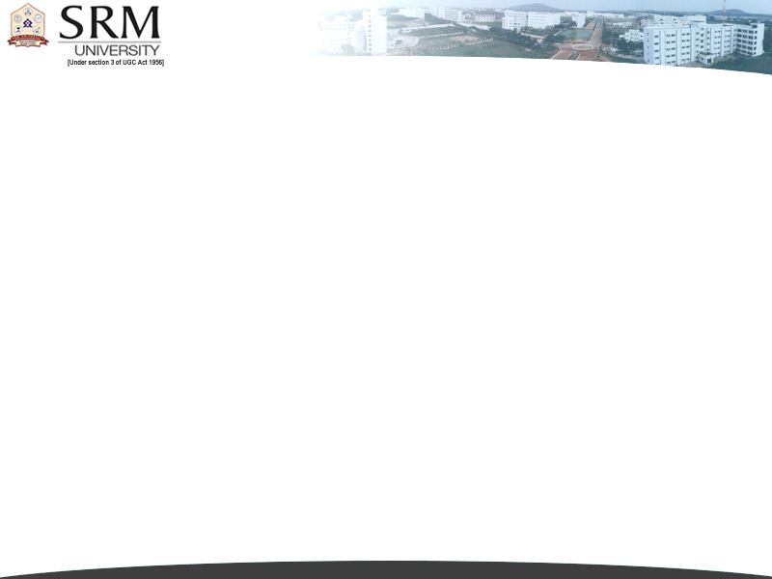
Belt Drive
BELT DRIVE
A belt drive is a method of transferring rotary motion between two shafts(attached with pulleys).
It is a looped strip of flexible material, used to mechanically link two or more rotating shafts.
Belt drives may be used as a source of motion, to efficiently transmit power, or to track relative movement.
Generally belt drives are friction drives.

Slide 5
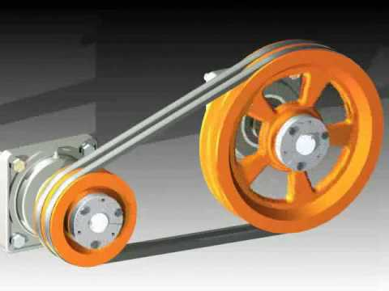
Simple belt drive system

Slide 6
Application
Where the rotational speeds are different
Distance between the shafts is high
Motion or power that needs to be transmitted to more number of applications

Slide 7
Types of belts
Flat belt
V belt
Round belt
Timing belt

Slide 8
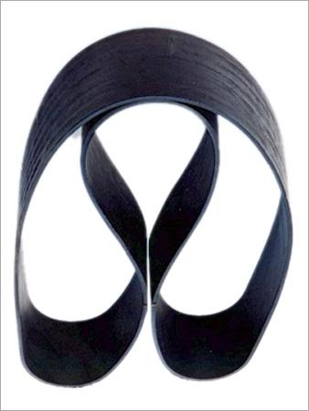
Pictorial view of belts
Flat belt

Slide 9
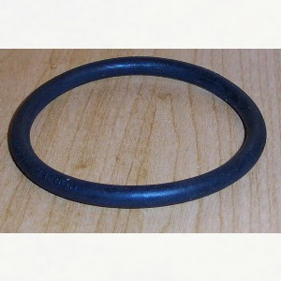
Round belt

Slide 10
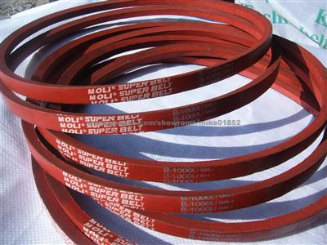
V belt

Slide 11
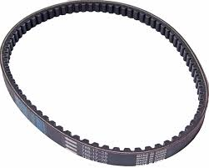
Timing or grooved belt

Slide 12
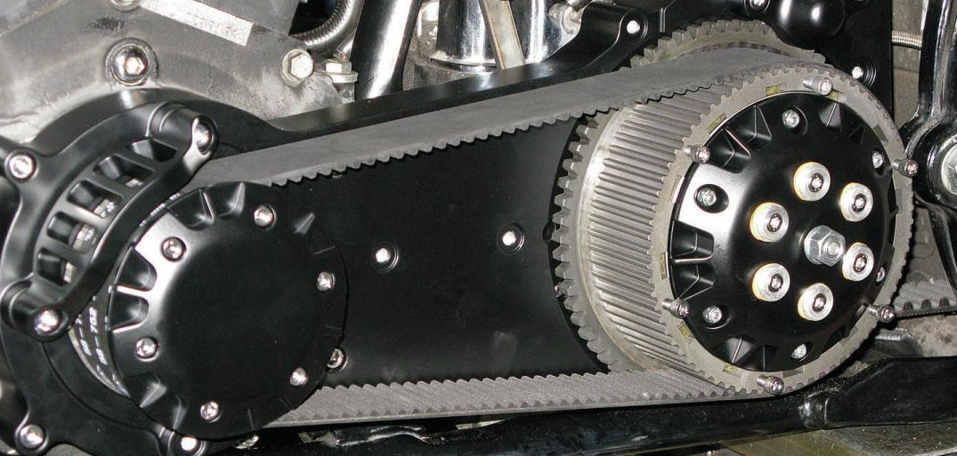
Pictorial view

Slide 13
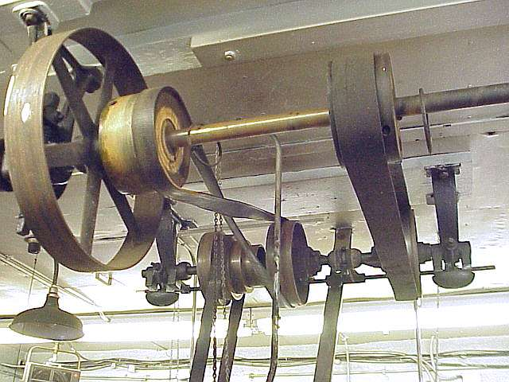
Pictorial view

Slide 14
Materials used for belt drives
Oak tanned leather – fairly stiff
Chrome leather belt – for oil and steam environment
Fabric belts - (Canvas or cotton duck)
Rubber belts – layers of fabric impregnated with rubber or vulcanized rubber

Slide 15
Types of Belt drives
Open belt drive
Crossed belt drive

Slide 16
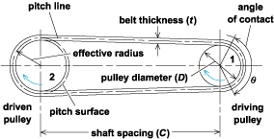
Open belt drive

Slide 17
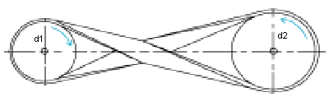
Crossed belt drive

Slide 18
Terminology
Length of the belt
Velocity ratio
Slip
Tight side and slack side
Length of the belt
Angle of contact
Ratio between the belt tensions
Power transmitted

Slide 19
Ratios b/w belt tension and Power
R= T₁/T₂ =e^{µθ}
^{T1 = Tension in the tight side}
^{T2 = Tension on the slack side}
^{µ= coefficient of friction}
^{θ= angle of contact}
^{Power transmitted} P = (T₁₋T₂ )V
V= velocity of the belt
V= πd1 * N/60 m/s

Slide 20
Merits of belt drive mechanism
They are simple. They are economical.
Parallel shafts are not required.
Overload and jam protection are provided.
Noise and vibration are damped out. Machinery life is prolonged because load fluctuations are cushioned (shock-absorbed).
They are lubrication-free. They require only low maintenance.
They are highly efficient (90–98%, usually 95%). Some misalignment is tolerable.
They are very economical when shafts are separated by large distances.

Slide 21
Demerits of belt drive
Non compact
Constant velocity cannot be obtained
Slippage
Not applicable for heavy loads

Slide 22
Real time applications
Lathe , drilling and sewing machines
Compression systems
Automobiles
Water systems
Power generation units
Air conditioning systems

Slide 23
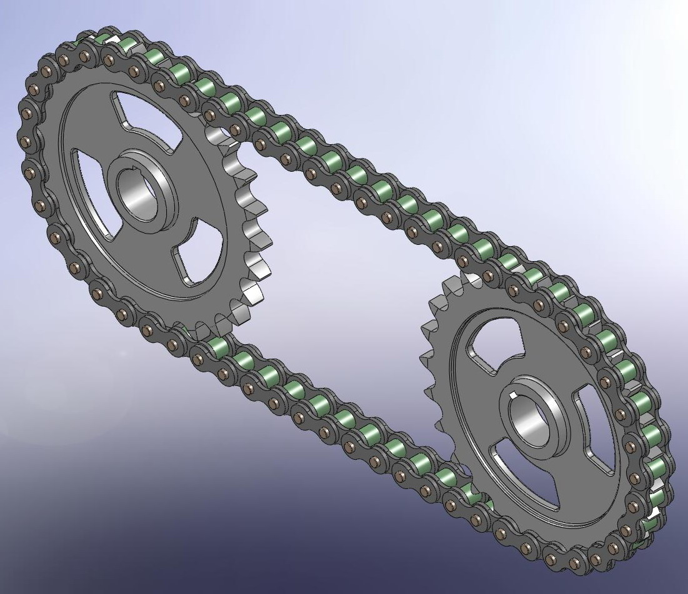
CHAIN DRIVES

Slide 24
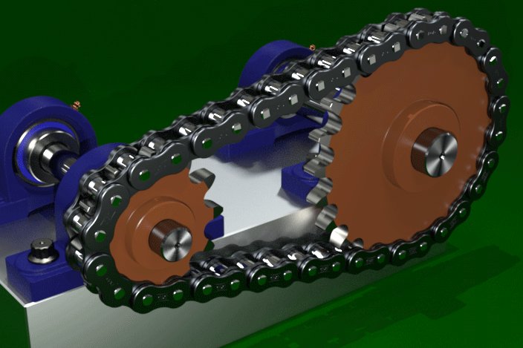
Animated view

Slide 25
Applications
Where slippage needs to be reduced to a considerable amount
Initial torque developed is more
Continuous drive systems
Smaller center distance
Agro machinery , automobiles,cranes

Slide 26
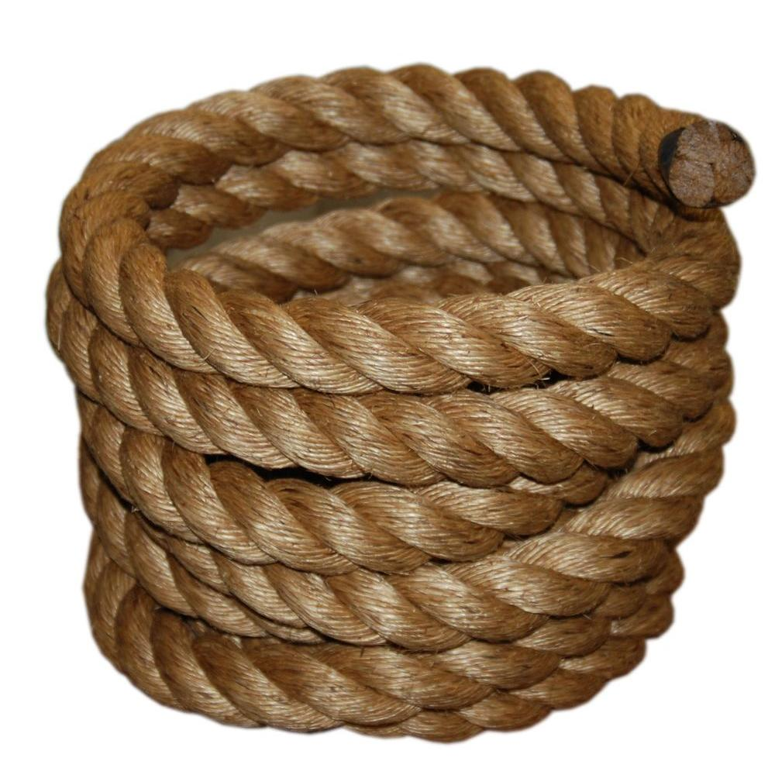
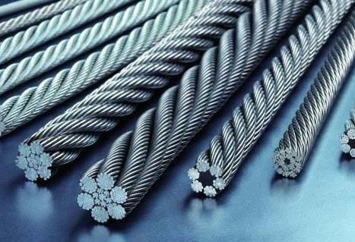
Rope Drive
They are similar to belt drive
They are classified as:
Fibre Rope – Made of Manila or Cotton
Wire Rope – Made of Steel wires

Slide 27
Gear systems
Machine elements that transmit the motion and power between the rotating shafts by means of successively engaging teeth .
Compact than the other drive systems
More accurate power transmission
Less slippage

Slide 28
Common forms of gear configuration
Gears for connecting parallel shafts
Gears for connecting intersecting shafts
Gears for connecting neither parallel nor intersecting shafts

Slide 29
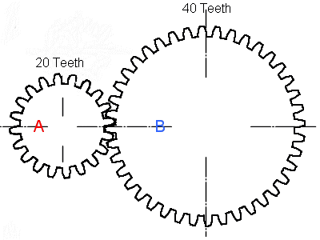

Slide 30
Gear types for connecting parallel shafts
Spur gears (internal and external)
Parallel helical gears
Double Helical/Herringbone gear

Slide 31
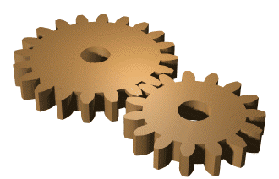
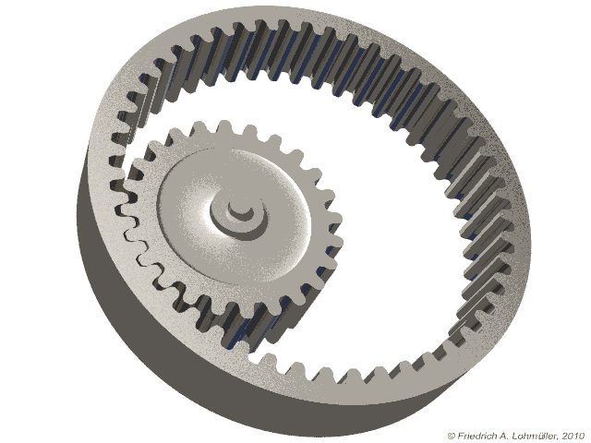
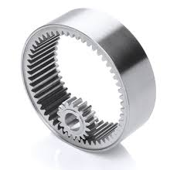
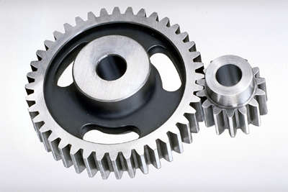
Spur gear
Teeth are parallel to the axis of shaft
Internal gearing & External gearing
Easy to find, inexpensive and efficient
Can not be used when a direction change
between the two shafts is required
Used for smaller speed due to noise creation
at higher Speed
Examples- Gear boxes, Machine tools, Watches
Automobiles, Precision Measuring Instruments etc.

Slide 32
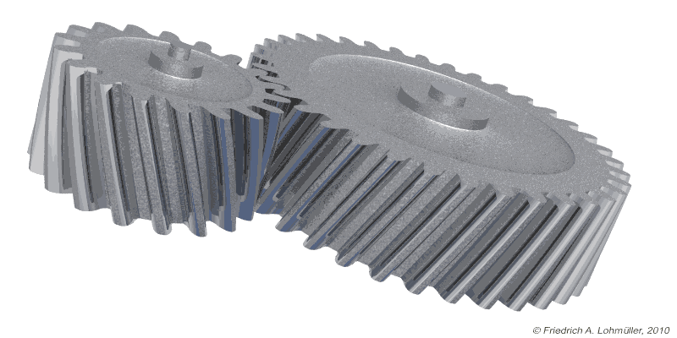
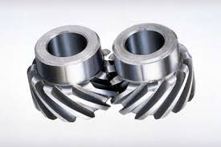
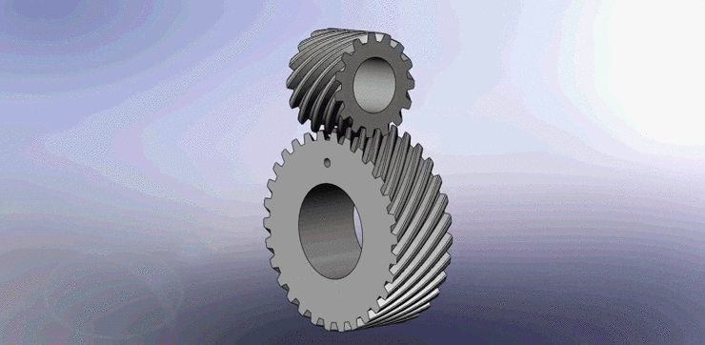
Helical Gear
Teeth are at an angle to the shaft
They are longer than the teeth on spur gear
Tooth strength is greater than spur
Carry more load
Due to longer length reduce efficiency
Advantages
It can be used on non parallel and even perpendicular
Shafts and can carry higher load than spur
Disadvantages
More expensive and difficult to manufacturing

Slide 33
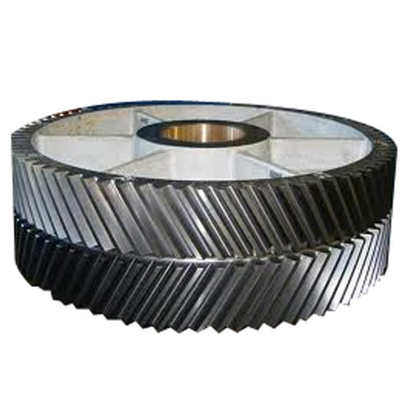
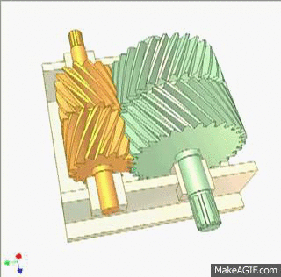
Double Helical/Herringbone gear
They have a right hand helix and left hand helix
The teeth of two rows separated by groove used for tool run out
Run at high speed with less noise and vibration
They eliminate thrust load as in case of single helix

Slide 34
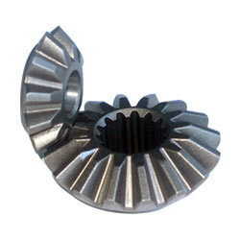
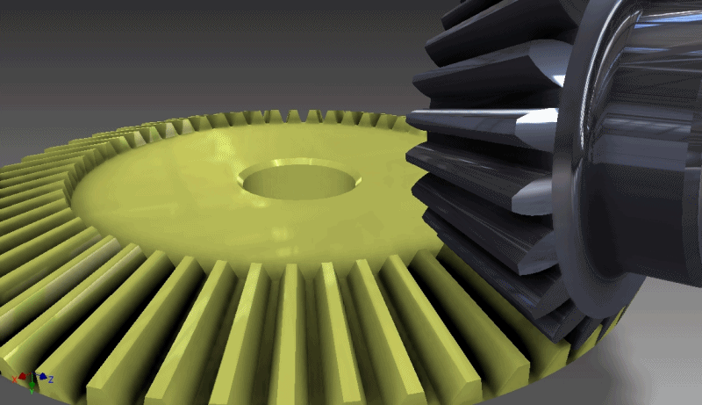
Gears for connecting interesting shafts
Bevel gear
Transmit power between intersecting shaft
Teeth of these gears are formed on conical surface
More application in Automobile
It can not be used for parallel shaft and becomes noisy at high speed

Slide 35
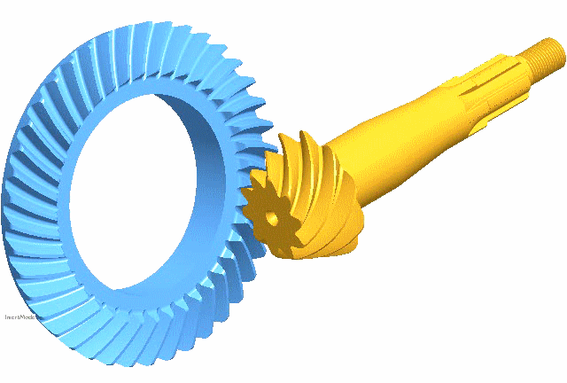
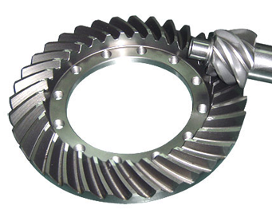
Neither interesting nor parallel Shaft
Hypoid Gear
They are resembles spiral bevels
There axes of the shafts do not intersect
Used only the shafts of drive are non intersecting and non parallel
Used in Automobile differential unit

Slide 36
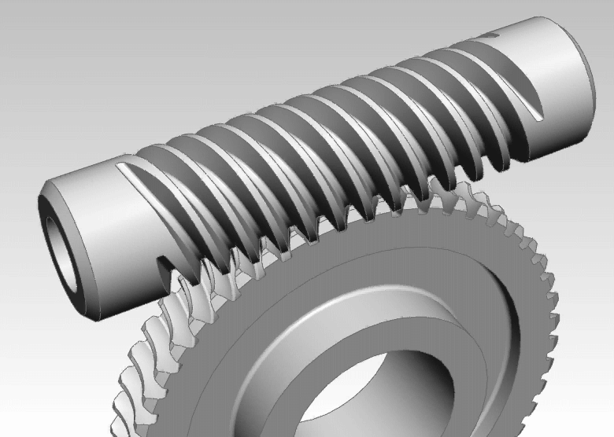
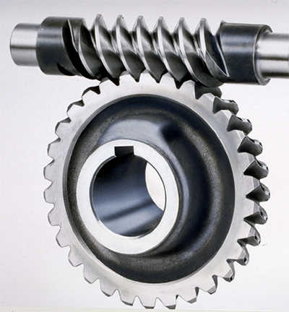
Warm Gear
It is combination of screw with helical gear
The screw with one or more threads is called Worm
They are used to achieve high velocity ratio
That is they are mainly used to either increase or decrease speed.
Used in Lathe, milling drilling machines etc

Slide 37
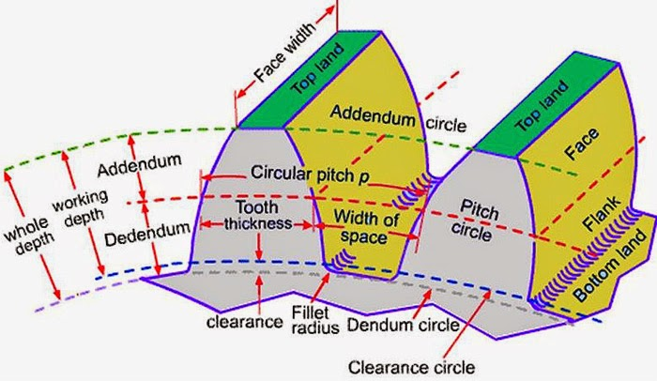
Gear Terminology

Slide 38
Types of gear trains
Simple gear train
Compound gear train
Reverted gear train
Epicyclic gear train
Planetary gear train

Slide 39
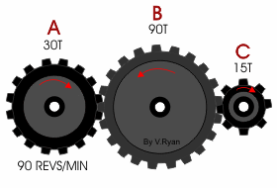
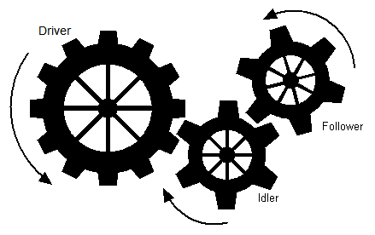
Simple gear train

Slide 40
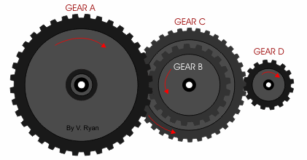
Compound gear train

Slide 41
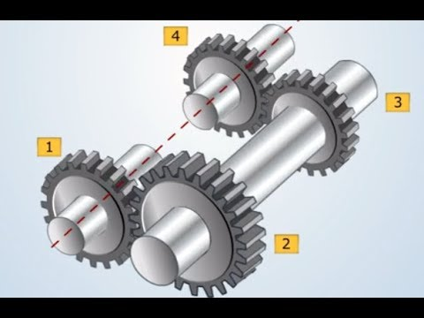
Reverted Gear Train

Slide 42
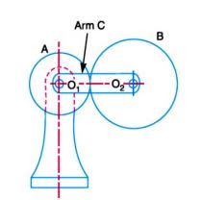
Epicyclic Gear Train

Slide 43
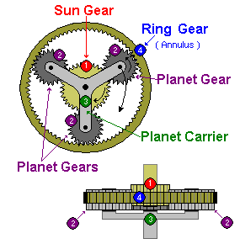
Planetary gear train
Also termed a epicyclical gear

Slide 44
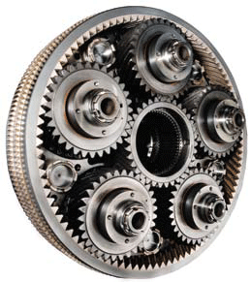

Slide 45
Gears in real time application
Automobiles
Machine systems
Pumping systems
Machine tools
Timing and related equipments

Slide 46
Merits and Demerits
Merits:
Compactness
Greater speed amplification and reduction of speeds
Less slip
Direct contact with the driver

Slide 47
Merits and Demerits
Demerits
Wear and tear
Required coolant for reduction of heat developed
Back lash
Noise and vibration

Slide 48
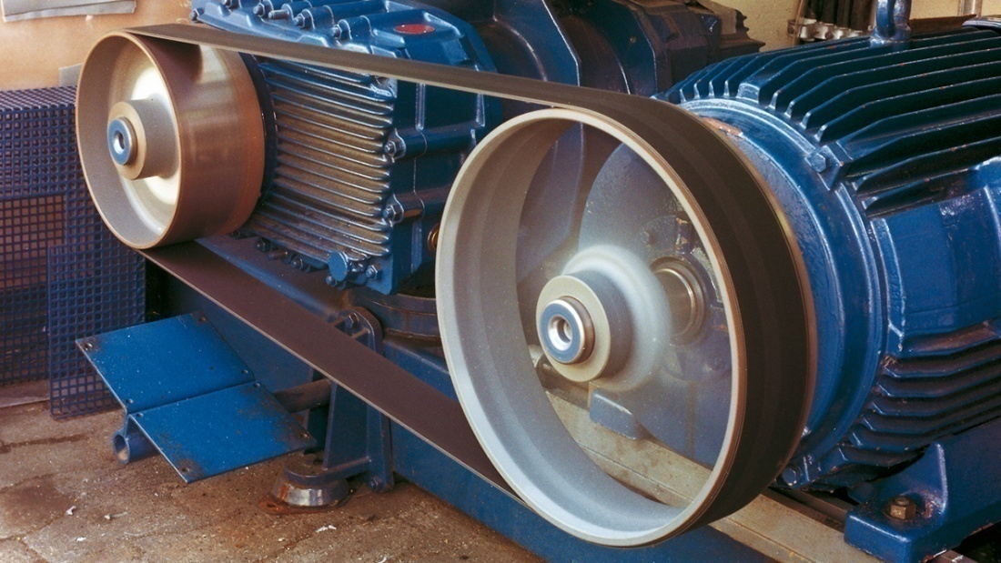
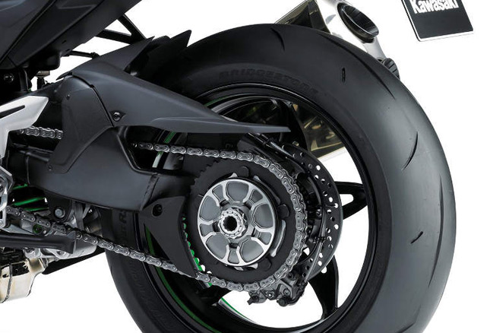
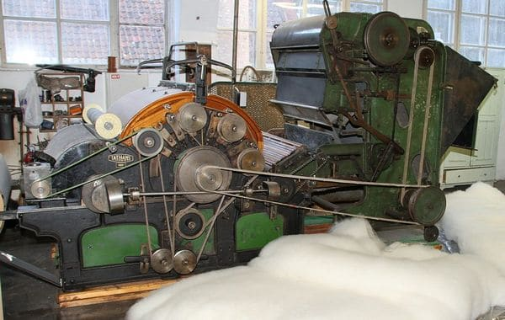
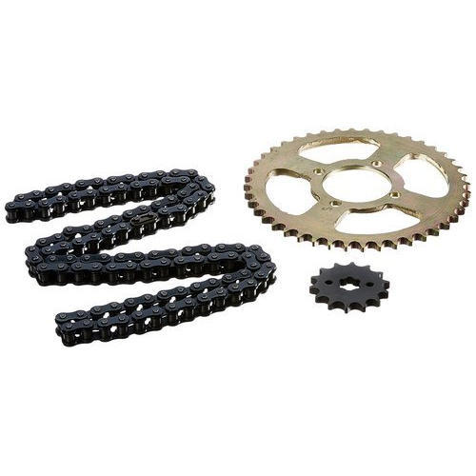

Slide 49
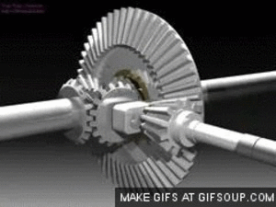
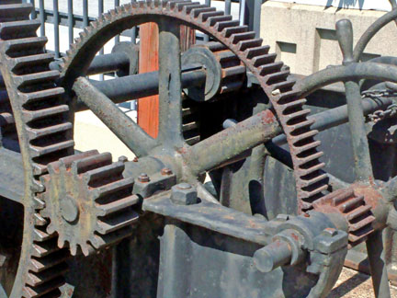
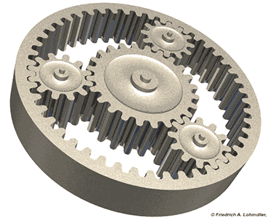
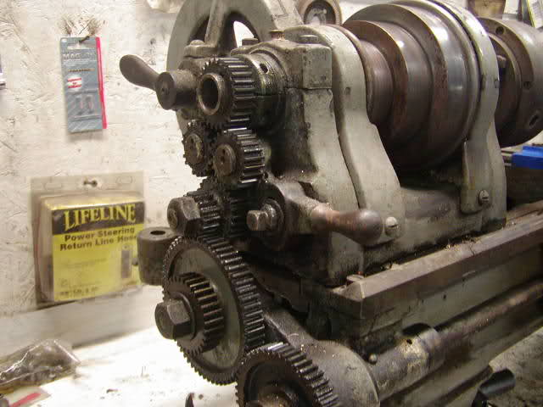

Slide 50
Thank You

